Slide 1
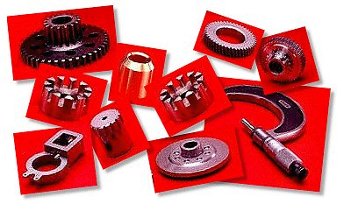
Powder metallurgy
Visit for more Learning Resources

Slide 2
Co related to chapter
Use powder metallurgy processes for different engineering applications.
Describe Non destructive testing methods for engineering material testing.

Slide 3
Introduction
Powder metallurgy is a branch of metallurgy which deals with the production of metal and nonmetal powders and subsequently manufacture of components by using these powders.
It is process in which powdered materials are BLENDED,PRESSED into desired shape and then HEATED to bond surface.

Slide 4
Steps involved in production of component (processes)
Powder production
Blending or mixing
Compacting(i.e. pressing)
Sintering
Sizing or impregnation
Testing and inspection.

Slide 5
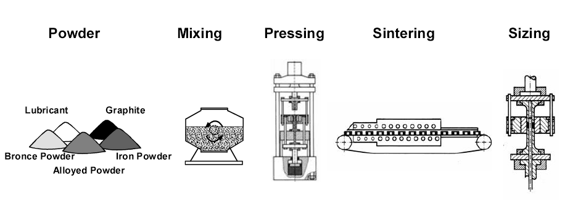
Steps involved in manufacturing powder metallurgical component
Powder Metallurgy

Slide 6
1) Powder production
Powders are manufactured by various methods and the powder from each method has typical properties.
Mechanical process
Machining
This method is used to produce filings, turning ,chips etc. which are subsequently pulverized by crushing and milling.
Since relatively coarse powders are obtained by this method, it is suitable only for few special cases such as Mg powder in pyrotechnic applications, silver solders and dental alloys.
The powder particles are of irregular shape.

Slide 7
1) Powder production
B) Crushing
The solid materials are crushed by hammers, jaw crushers, gyratory crushers, etc .the powder particles of brittle material are angular in shape and ductile material are flaky in shape.
Any material can be crushed to powder form; however, the method is very much suitable for brittle materials.
C) Milling:
Milling is the most important and widely used method for the production of powders of required grade and fineness.
Milling is done by using equipments such as ball mills, rod mills, eddy mills etc.

Slide 8
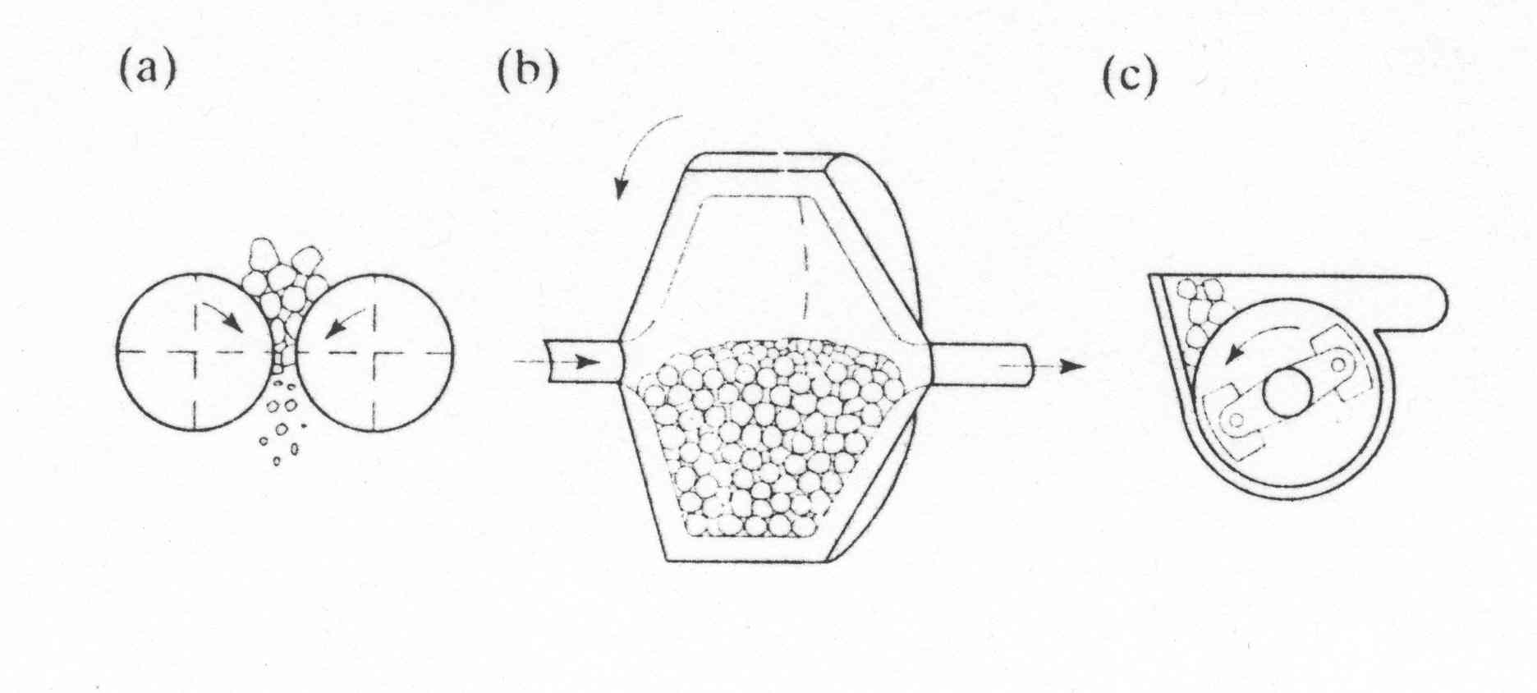
Powder Production
Mechanical:
Roll crusher (b) Ball mill

Slide 9
1) Powder production
In ball milling methods, the material to be powdered is tumbled or rotated in a container with large number of hard balls.
The speed of container is properly controlled so that the balls hit the material making particles finer and finer.
Milling may be done by dry or wet method. In wet method, a liquid medium such as distilled water ,alcohol, acetone, or stearic acid is used in the drum.
Any type of material can be powdered by milling method. However it is widely used for carbide –metal mixtures.
D) shotting:
In this method molten metal is poured on a vibrating screen and liquid droplets are solidified either in air or a neutral gas.

Slide 10
1) Powder production
The size and characters of the powder depends on the temperature of molten metal, size of openings in the screen and frequency of vibrations of the screen.
Shape of particle is nearly spherical.
E)Graining :
Graining involves the same procedure as shotting, the only difference being the solidification of molten metal droplet is done in water.
The powder obtained by shotting and graining method are coarse and subsequently pulverization methods are used for further reduction of size.

Slide 11
Powder Production
Mechanical:
Automization
Produce a liquid-metal stream by injecting molten metal through a small orifice
Stream is broken by jets of inert gas, air, or water
The size of the particle formed depends on:
Temperature of the metal
Metal flowrate through the orifice
Pressure of jet
Nozzle size and jet characteristics

Slide 12
Powder Production
The process consists of main three stages
Melting
Atomization
Solidification and cooling
Melting is done by induction, arc, plasma
or electron-beam technique to maintain purity
of melt.
Atomization is done by high velocity water,
compressed air or inert gas.
The disintegrated particles are solidified in
controlled atmosphere, vacuum , air or water.
Main two types of techniques:
Water Atomization
Gas Atomization

Slide 13
Powder Production
Main two types of Automization Techniques:
Water Atomization
Gas Atomization

Slide 14
Gas Atomisation
Compressed air, nitrogen, argon or helium are used for disintegration.

Slide 15
Water atomization technique for production of powders
Water Automization

Slide 16
1) Powder production
Physical processes
condensation:
In this method ,metal vapours are condensed to obtain metal powders.
This method is highly suitable for volatile metals because they get easily transformed to their vapours.
Large quantities of Zn ,Mg and Cd powders are manufactured by this method.
The powder shape is nearly spherical.

Slide 17
Characteristic of Metal powder
Chemical composition
Particle shape, size and its distribution
Particle porosity
Specific surface
Compacting properties
Sintering properties

Slide 18
2)Mixing or blending
The metal obtained from above methods may not be suitable for their further processing . To make them suitable, powder conditioning is done which involves mechanical, chemical or thermal treatments or alloying and are described below:
1)Annealing :
Before mixing or blending of powders, annealing is usually done in reducing atmosphere or in vacuums.
This eliminates work hardening effect, reduces the oxide content and impurity level and alters the apparent density.
High temp. annealing increases the apparent density of powder and reduces the pressure requirements: whereas,

Slide 19
Mixing or blending
low temp annealing decreases apparent density of powder and increases the pressure requirements during compaction.
These powder form a spongy mass during annealing and hence it is pulverized to obtain powder.
Mixing or blending.
In this process ,through mixing of powders of same material or of different material is done for obtaining the desired properties during compaction ,sintering and in the final sintered component.

Slide 20
Mixing or blending
This gives uniform distribution of particles in the compact and consistent performance of the powder during pressing or sintering.
For obtaining this at improved levels, small amount of lauryl alcohol or camphor is usually added to the powder during mixing.
This also improves bonding of particles which improves green strength of compacts.
Various types of machines are used for mixing or blending; however a double cone or y cone mixer is more common.

Slide 21
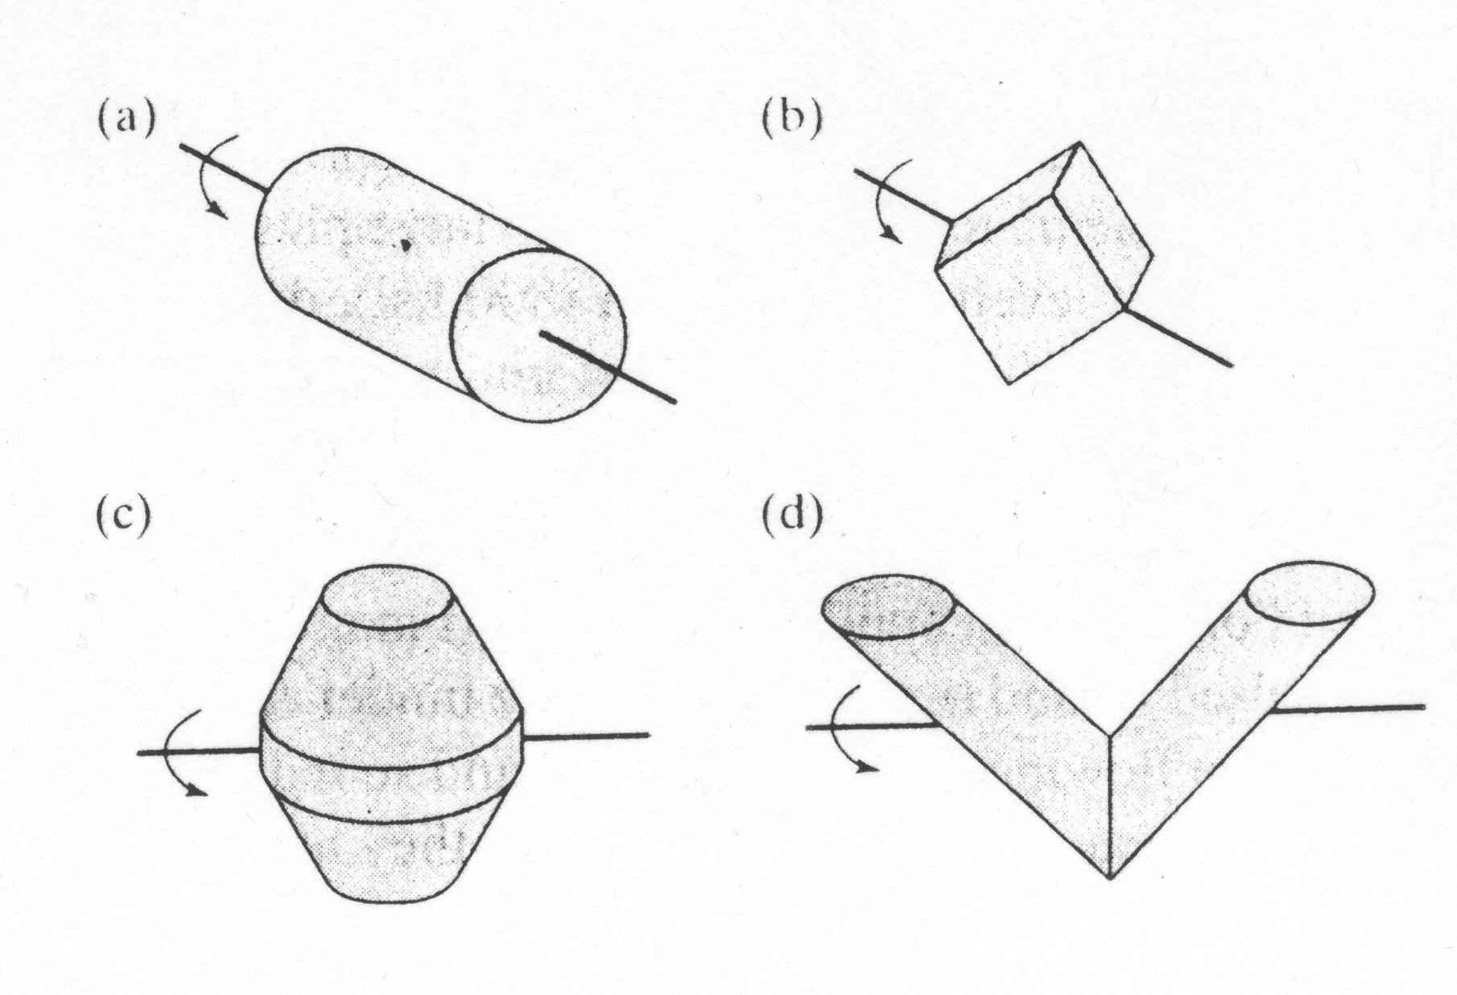
Blending and Mixing
Some common equipment geometries used for blending powders
(a) Cylindrical, (b) rotating cube, (c) double cone, (d) twin shell

Slide 22
Mixing or blending
Certain material like graphite, Mos2, stearic acid, stearates of Zn and Li, etc are added to these powders during mixing which may have one or more of the following functions:
1)It may acts as a lubricant, reducing the friction between the punch and the die walls.
2)It may easily transform to a gas or vapour which creates porosity during sintering. This can be used to control porosity of the component.
3)It may acts as binder , increasing green strength which facilitates handling of cold compacts.

Slide 23
3)Compacting
Compacting in metal dies is one of the most important methods for shaping of metal powders.
Powder mix is fed in to the die cavity through a hopper and feed shoe. And feed shoe is oscillated to assist the powder flow.
The volume of the powder is controlled by adjusting the position of the bottom punch in the die cavity.
When the die has been evenly filled with powder, these upper surface is leveled by a sweep of feed shoe and top punch is pushed in to the die cavity.
The pressure is then applied on any one punch or simultaneously on both the punches to compact the powder.

Slide 24
Compacting
After maximum compression the upper punch is removed and the compact is ejected by raising the lower punch, leaving it free for next similar operation.

Slide 25
Compacting
Most important effect of compacting are as follows
1)It reduces voids between powder particles and increases the density of compact.
2)It produces adhesion and cold welding of the powders and gives sufficient green strength.
3)It is plastically deforms the powder and allows recrystallization during subsequent sintering.

Slide 26
4) sintering
Sintering is carried out to increase strength and hardness of a green compact and consists of heating the compact to some temperature under controlled conditions with or without pressure for a definite time.
Sintering process is concerned with:
Diffusion: this takes place especially on the surface of the particles as the temperature rises.
Densification: this decreases porosity present in the green compact and increases the particle contact area. Due to this, the compact size decreases. This decrease may not occur

Slide 27
Sintering
The possible diffusion mechanisms are
Surface diffusion
Volume diffusion
Grain boundary diffusion
Evaporation and condensation

Slide 28
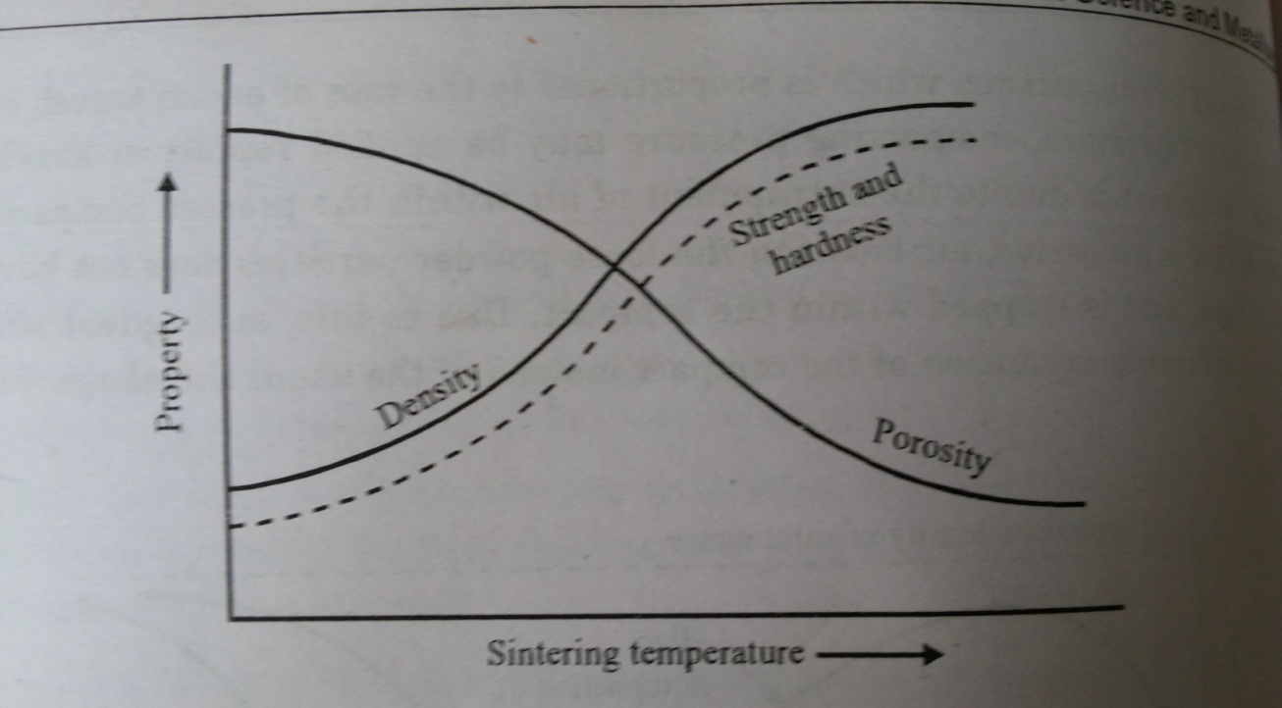
4) sintering
uniformly because of variation in the density of compact and hence this leads to the distortion of component.
c) Recrystallization and grain growth: This occurs between the particle at the contact area, leading to a structure similar to original one.

Slide 29
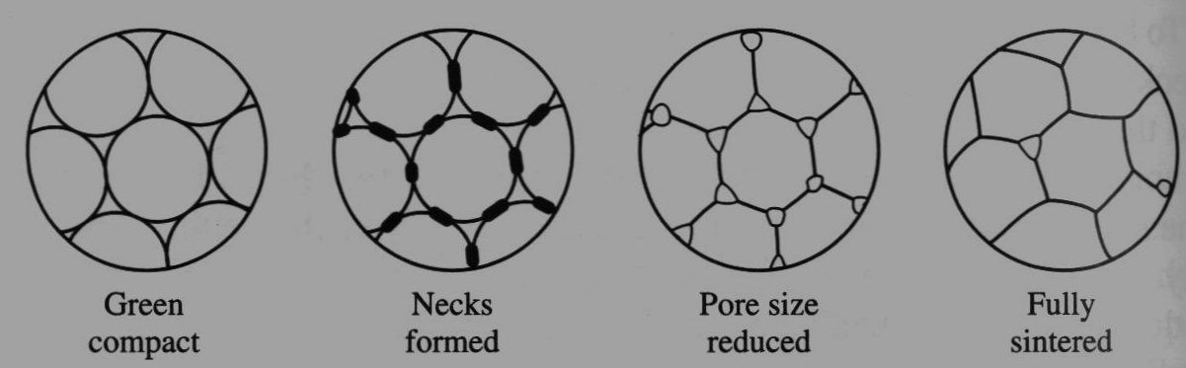
4) Sintering
Parts are heated to ~80% of melting temperature
Transforms compacted mechanical bonds to much stronger metal bonds
Many parts are done at this stage. Some will require additional processing

Slide 30
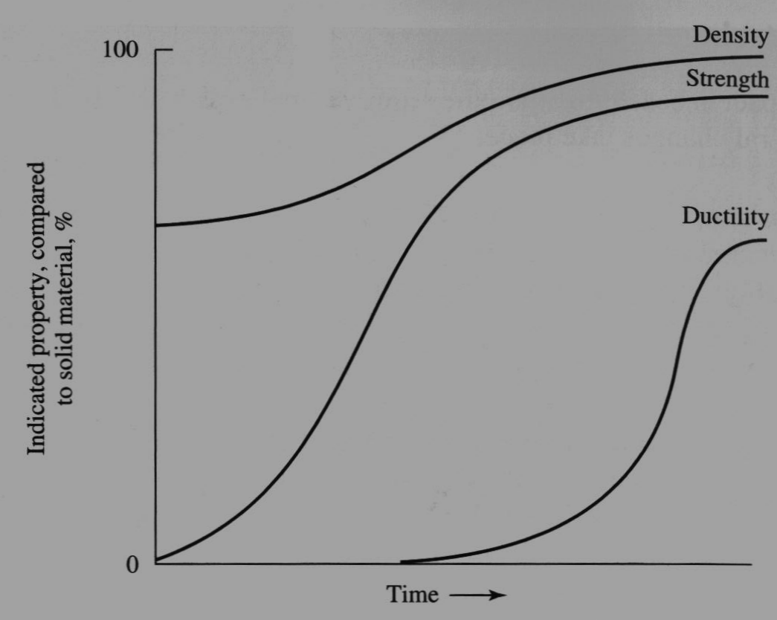
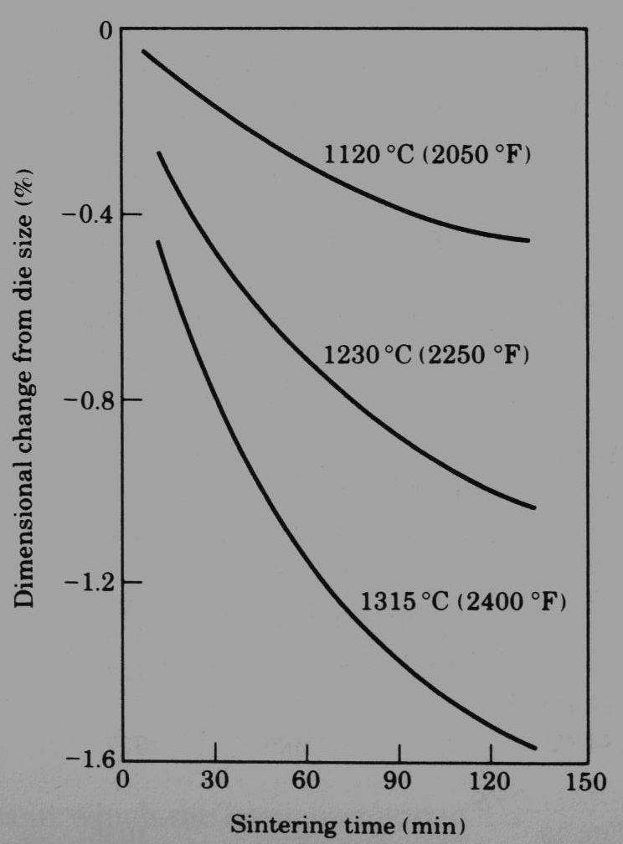

Slide 31
4) sintering
Depending upon temperature of sintering, sintering process is classified as solid phase sintering or liquid phase sintering.
The most common method is solid phase sintering in which the green compacts are heated usually above the recrystallization temperature of low melting metal.
The liquid phase sintering is carried out above the melting point of one of the alloy constituents or above the melting point of an alloy formed during sintering.

Slide 32
5)sizing(coining) or impregnation:
The sintered compact may have slightly different size from the desired one due to distortion occurring during the sintering process.
The size restriction is done by placing the component in a master die and applying pressure. This is called sizing

Slide 33
sizing(coining) or impregnation:
Due to this the interconnected porosity is likely to closed and fillings of these pores with oil or some other metal (i.e. impregnation)will not possible.
Therefore, if the component is to be impregnated, sizing should be avoided.

Slide 34
Testing and inspection
The component should be tested for various properties before it is put to the service.
The various test which are conducted are compressive strength, tensile strength, porosity, density, hardness, composition, microstructure, etc.
It is also inspected for size, shape and amount of defects. once component satisfies the properties, it is ready for use.
Final properties of a sintered component depend upon:
Size , shape, distribution, porosity, density, chemical composition, surface characteristics, etc of particles.
Compacting pressure, type and amount of lubricant used,

Slide 35
6)Testing and inspection
etc.
3) Sintering temp.and time, type of sintering etc.
4) Type of atmosphere.

Slide 36
Advantage of powder metallurgy
1)Metal plus metal components can be manufactured by P/M.
2)Metal plus non metal component can be manufactured by P/M.
3)Controlled porosity can be obtained bin the component.
4)It is possible to produce components with properties similar to the parent metals.
W or Mo (high hardness) + Cu or Ag (good electrical conductivity)→ product(high hardness, good electrical conductivity)
5)Manufacture of cemented carbide cutting tools is only possible by P/M.

Slide 37
Advantage of powder metallurgy
6)P/M parts may be welded, brazed, machined, heat treated, plated or impregnated with lubricants or other materials.
7)Some of the metal powders find application in other field such as painting, welding, explosives, plastics and R.c.c.
8)Close control over the dimension of the finished part can be easily obtained.
9)No machining or minimum machining is required and hence the scrap is minimum.
10)Fast production of simple shaped component is possible due to lesser number of steps involved.
11)Highly skilled or qualified personnel is not required for plant operation and maintainace.

Slide 38
limitation of powder metallurgy
1)Most of the powder used in P/M are fine and fine powders of some of the metals like Mg,Al,Zr,Ti etc. are likely to explode and cause fire hazards when they come in contact with air and hence, they should be preserved carefully.
2)It is not suitable to manufacture small number of component because of high initial investment on tooling and equipment.
3)Large sized component can not be manufacture because of the limited capacity of presses available for compaction.
4)Complex shaped part can not be manufactured with ease by
P/M.
5)P/M part have poor corrosion resistance because they are porous.

Slide 39
limitation of powder metallurgy
6)Components with theoretical density can not be manufactured.
7)Due to the presence of porosity, mechanical properties such as ductility,u.t.s. and toughness are poor as compared to components manufactured by conventional methods. The surface finish is also poor.

Slide 40
properties of powder particles
1)Specific surface:
It is defined as the total surface area of a powder per unit weight(cm2/gm).
It depends on size, shape, density, and surface conditions of the particles.
2)Density:
Apparent density:
Apparent density of a powder is defined as the mass per unit volume of loose or unpacked powder.
The lower apparent density of the powder, the longer will be compression stroke and deeper dies will be required to produce a compact of given thickness and density.

Slide 41
properties of powder particles
b) Tap density:
The tap density is the apparent density of the powder after it has been mechanically shaked or tapped until the level of powder remains constant.
This has same effect as apparent density on pressing characteristics.
3)Flow rate:
It is defined as the rate at which a metal powder will flow under gravity from container through orifice having specific shape and size.
Flow rate depends on particle size, shape, distribution , amount of absorbed gases, amount of moisture and coeff. Of friction.

Slide 42
properties of powder particles
5)compressibility:
It is defined as the powder ability to under go deformation under the applied pressure.
6) compactibility:
It is defined as the minimum pressure required to produce a compact of given green strength.
7) Green density:
It is density of a cold compact.
Weight of the compact/ volume of compact.
Green density increases with increase
a)Compaction pressure b) particle size c)apparent density

Slide 43
properties of powder particles
d)Decrease of particle irregularity e)decrease of particle hardness f) decrease of compacting speed.
8)Green strength:
It is mechanical strength of green compact of green compact
The strength of green compact is depend upon the shape ,size, distribution, surface condition, hardness, yield strength, etc.
9)Mechanical properties:
Compressive strength, hardness.
10)Microstructure

Slide 44
Oil impregnated porous bearing(self lubricating bearing)
Bronze bearings are widely used and made up of cu and Sn (90:10) with addition of graphite.
Graphite acts as solid lubricant.
Processes:
1)Mixing
2)Cold compaction
3)Sintering
4)Repressing or sizing
5)impregnation

Slide 45
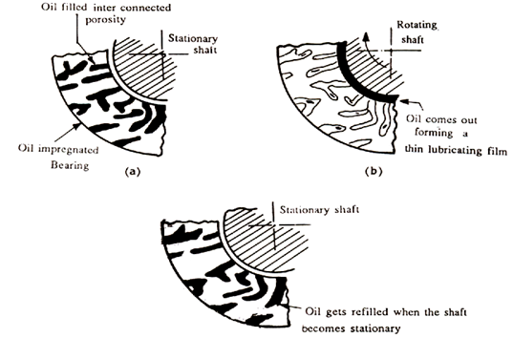
Oil Impregnated Porous Bearings (Self Lubricating Bearings)
The working of the bearing

Slide 46
Oil impregnated porous bearing(self lubricating bearing)
Metal powder of cu and Sn with small amount of fine natural graphite are blended or mixed to obtain the desired alloy composition(90 cu: 10 sn)
This powder is cold compacted at pressures between 20 to 50 kg/mm2 to form green compact of desired shape and size.
These compacts are sintered in a reducing atmosphere at a temp. of about 800c.
A typical sintering consists of holding compact at 400-450c for removal of part of graphite and diffusion of molten Sn in to the copper, followed by further heating to 800c for 5 minutes.

Slide 47
Oil impregnated porous bearing(self lubricating bearing)
At this temp. a tin rich liquid phase is formed which is absorbed by copper.
Distortion occurring during sintering can be eliminated by repressing(i.e. repressing) or machining.
The repressed or machined components are impregnated with cold or hot oil using pressure, vaccum or a combination of these.
Such a oil impregnated bearing is called self lubricating bearing.

Slide 48
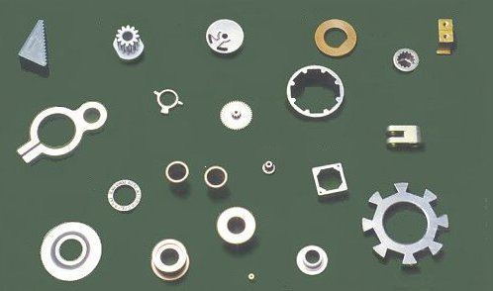
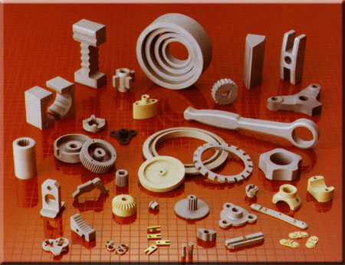
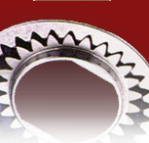
Application of P/M

Slide 49
Application of P/M
Automotive application
In motor car industry, porous bearings are used for starters, wipers, sliding doors, dynamos, clutches and brakes of cars, buses, trucks and tractors.
Electrical contacts, crank shaft drive, piston rings, connecting rod and brake linings are other powder metallurgy parts.
Sintered friction materials are used for brakes in cars, trucks, aircraft and similar application.
2) Defence application
Metal powder plays an important role in military and national defense systems. These poedr find use in rockets, missiles, cartridge cases,

Slide 50
Application of P/M
Bullets and military pyrotechnics such as tracers etc.
3)High temp. application:
Components made of w,Mo, and Ta by P/M are widely used in the electric light bulbs, fluorescent tubes, radio valves , mercury arc rectifiers and x-ray tubes in the form of filament, cathode, anode, screen and control grids.
Refractory metal carbides are used for dies, rolls, cutting tools, etc. at high temperature.

Slide 51
Application of P/M
4) Aerospace application:
Metal powder play an important role in rockets, missile, satellites and space vehicles.
Metal powder of Be, Al, Mg and Zr are used as solid fuels in rockets and missiles.
Tungsten parts with uniform distribution of porosity are used in plasma jet engine and ion engine which are operated at about 1800c
Bronze bearing, filters, ferrite cores for transformers and inductor coils and alnico magnetic materials in communication systems are used in various space satellites and vehicles.

Slide 52
Application of P/M
5) Other applications:
Parts in clock and timing devices, typewriters, adding machines, calculators, permanent magnets and laminated bimetallic strips.
The manufacture of some of the components such as sintered porous bearings, cemented carbides, refractory metals, etc.

Slide 53
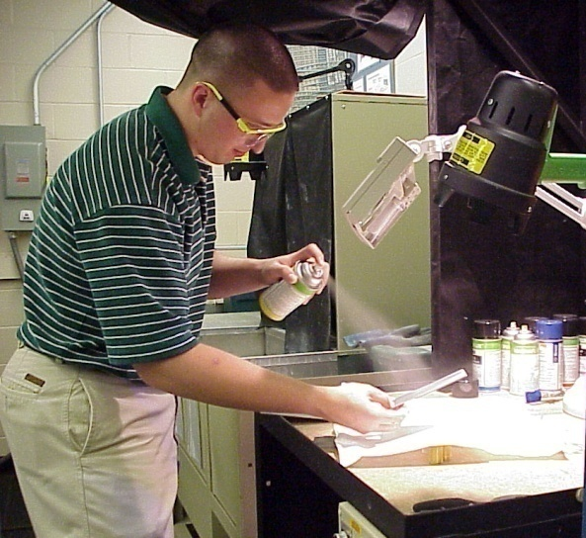
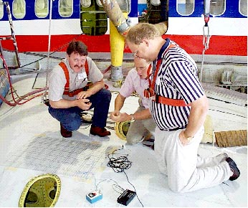
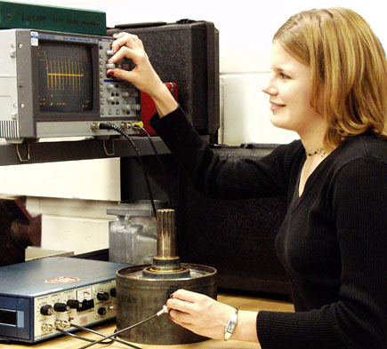

Introduction to Nondestructive Testing
Notes:
This presentation was developed by the Collaboration for NDT Education to provide students and other audiences with a general introduction to nondestructive testing. The material by itself is not intended to train individuals to perform NDT functions, but rather to acquaint individuals with some of the common NDT methods and their uses. All rights are reserved by the authors but the material may be freely used by individuals and organizations for educational purposes. The materials may not be sold commercially, or used in commercial products or services.
Comments are welcome at NDT-ed@cnde.iastate.edu.

Slide 54
Outline
Introduction to NDT
Overview of Six Most Common NDT Methods
Selected Applications

Slide 55
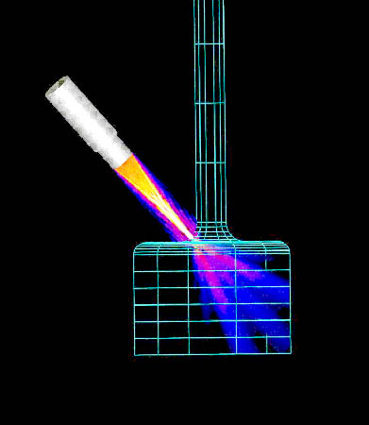
Definition of NDT
The use of noninvasive
techniques to determine
the integrity of a material,
component or structure
or
quantitatively measure
some characteristic of
an object.
i.e. Inspect or measure without doing harm.

Slide 56
Methods of NDT
Visual
Thermography
Microwave
Magnetic Particle
Tap Testing
X-ray
Acoustic Microscopy
Acoustic Emission
Magnetic Measurements
Liquid Penetrant
Ultrasonic
Replication
Laser Interferometry
Eddy Current
Flux Leakage

Slide 57
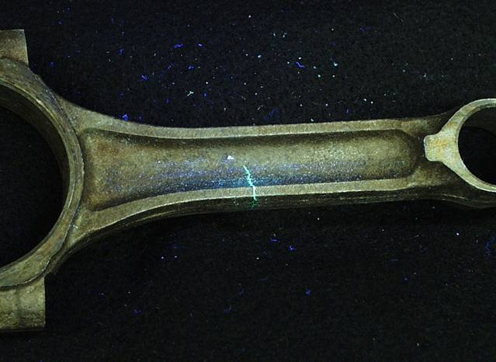
What are Some Uses of NDT Methods?
Flaw Detection and Evaluation
Leak Detection
Location Determination
Dimensional Measurements
Structure and Microstructure Characterization
Estimation of Mechanical and Physical Properties
Stress (Strain) and Dynamic Response Measurements
Material Sorting and Chemical Composition Determination
Fluorescent penetrant indication

Slide 58
When are NDT Methods Used?
To assist in product development
To screen or sort incoming materials
To monitor, improve or control manufacturing processes
To verify proper processing such as heat treating
To verify proper assembly
To inspect for in-service damage

Slide 59
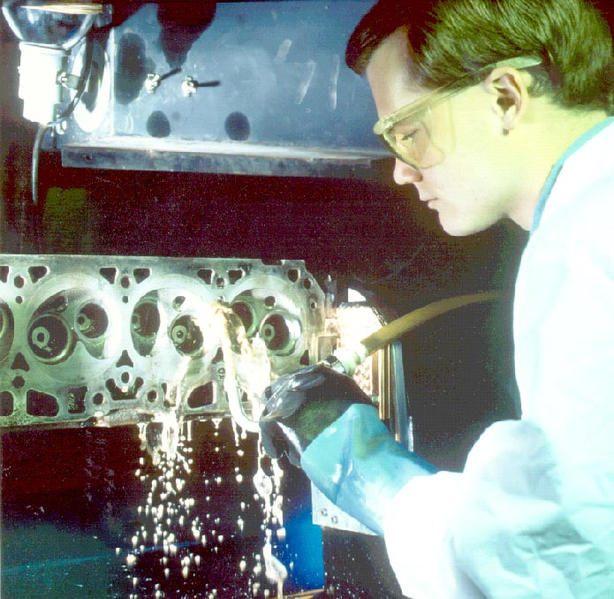
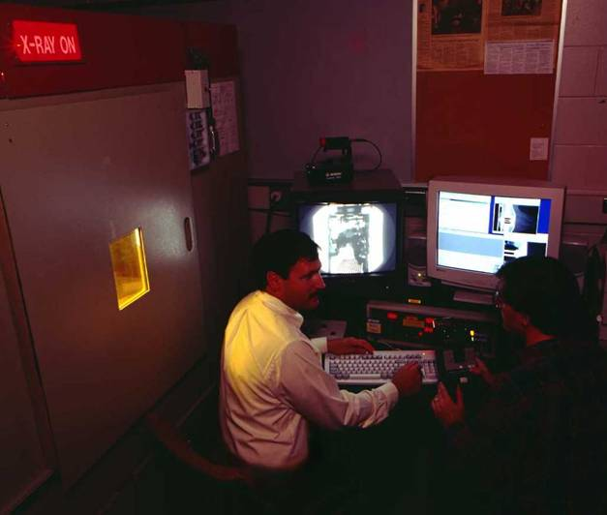
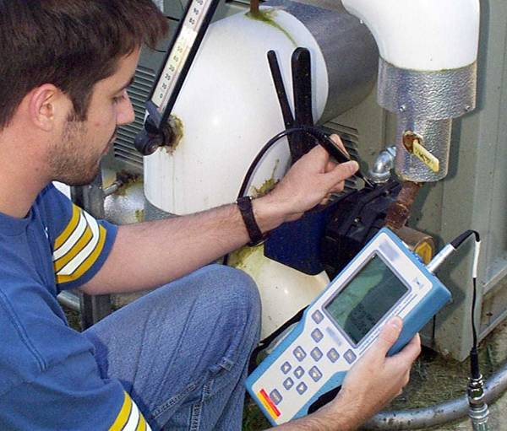
Six Most Common NDT Methods
Visual
Liquid Penetrant
Magnetic
Ultrasonic
Eddy Current
X-ray

Slide 60
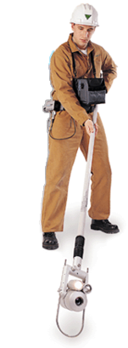
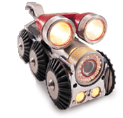
Visual Inspection
Most basic and common inspection method.
Tools include fiberscopes, borescopes, magnifying glasses and mirrors.
Portable video inspection unit with zoom allows inspection of large tanks and vessels, railroad tank cars, sewer lines.
Robotic crawlers permit observation in hazardous or tight areas, such as air ducts, reactors, pipelines.

Slide 61
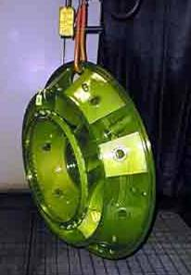
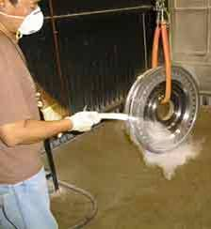
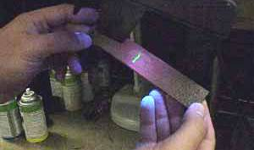
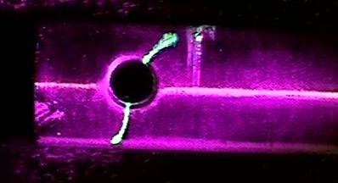
Liquid Penetrant Inspection
A liquid with high surface wetting characteristics is applied to the surface of the part and allowed time to seep into surface breaking defects.
The excess liquid is removed from the surface of the part.
A developer (powder) is applied to pull the trapped penetrant out the defect and spread it on the surface where it can be seen.
Visual inspection is the final step in the process. The penetrant used is often loaded with a fluorescent dye and the inspection is done under UV light to increase test sensitivity.

Slide 62
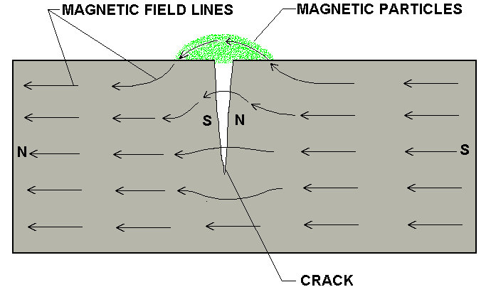
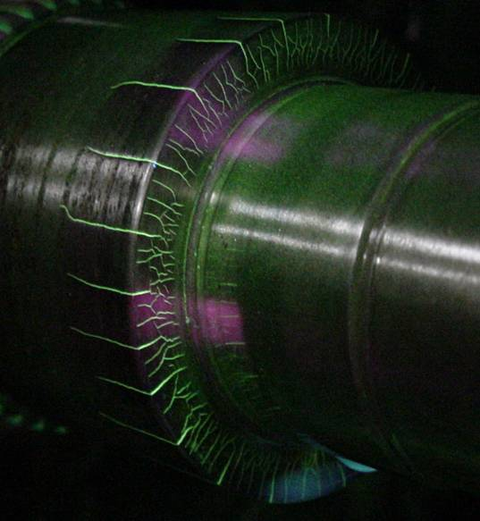
Magnetic Particle Inspection
The part is magnetized. Finely milled iron particles coated with a dye pigment are then applied to the specimen. These particles are attracted to magnetic flux leakage fields and will cluster to form an indication directly over the discontinuity. This indication can be visually detected under proper lighting conditions.

Slide 63
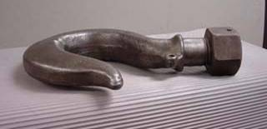
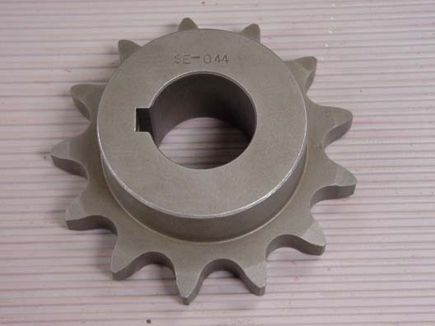
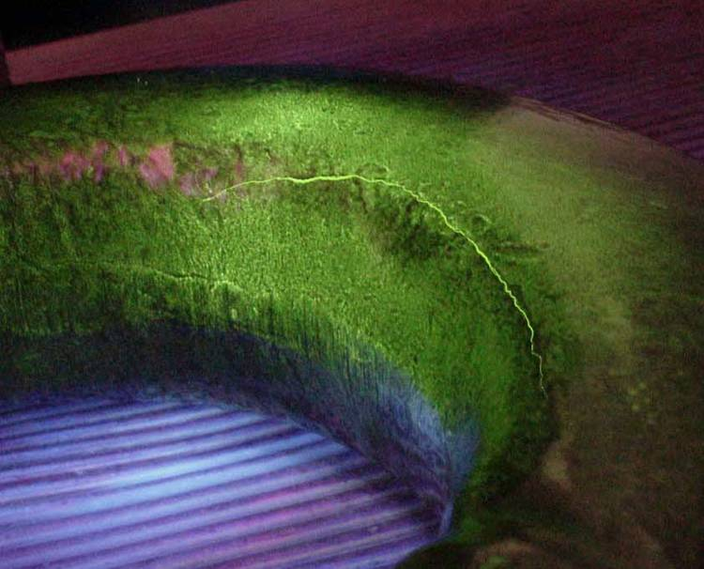
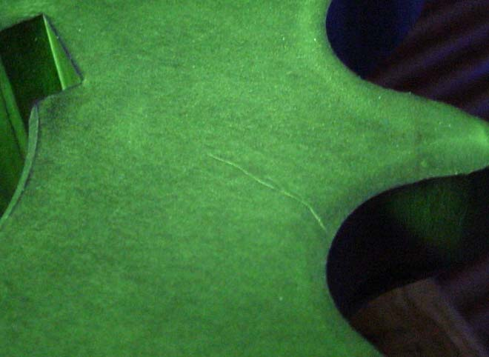
Magnetic Particle Crack Indications

Slide 64
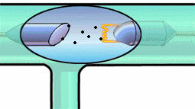
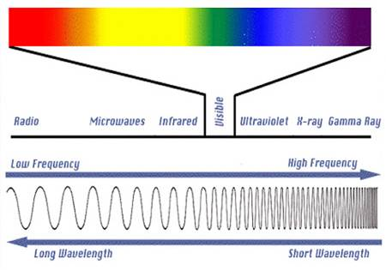
Radiography
The radiation used in radiography testing is a higher energy (shorter wavelength) version of the electromagnetic waves that we see as visible light. The radiation can come from an X-ray generator or a radioactive source.
High Electrical Potential
Electrons
+
-
X-ray Generator or Radioactive Source Creates Radiation
Radiation
Penetrate
the Sample
Exposure Recording Device

Slide 65
Film Radiography
The part is placed between the radiation source and a piece of film. The part will stop some of the radiation. Thicker and more dense area will stop more of the radiation.
The film darkness (density) will vary with the amount of radiation reaching the film through the test object.
X-ray film
= less exposure
= more exposure
Top view of developed film

Slide 66
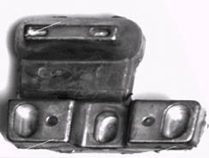
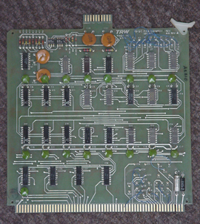
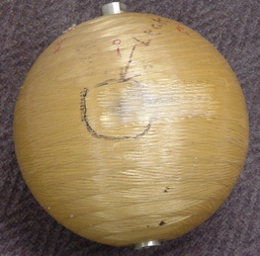
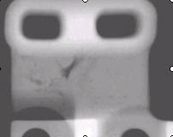
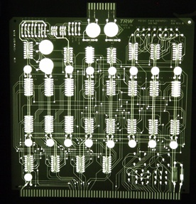
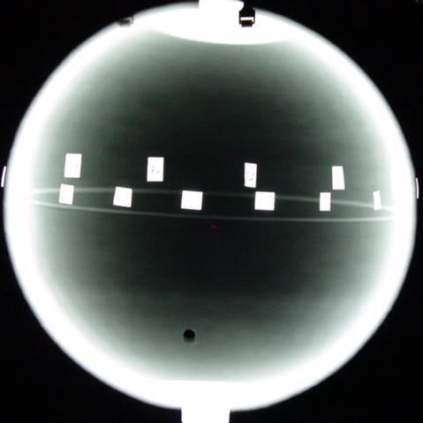
Radiographic Images

Slide 67
Eddy Current Testing
Coil's
Coil
magnetic field
Eddy current's
magnetic field
Eddy
currents
Conductive
material

Slide 68
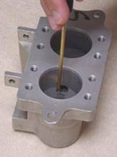
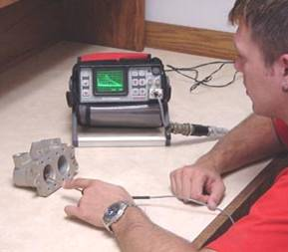
Eddy Current Testing
Eddy current testing is particularly well suited for detecting surface cracks but can also be used to make electrical conductivity and coating thickness measurements. Here a small surface probe is scanned over the part surface in an attempt to detect a crack.

Slide 69
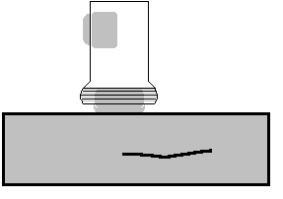
Ultrasonic Inspection (Pulse-Echo)
High frequency sound waves are introduced into a material and they are reflected back from surfaces or flaws.
Reflected sound energy is displayed versus time, and inspector can visualize a cross section of the specimen showing the depth of features that reflect sound.
f
initial
pulse
back surface
echo
crack
echo
crack
0
2
4
6
8
10
plate
Oscilloscope, or flaw detector screen

Slide 70
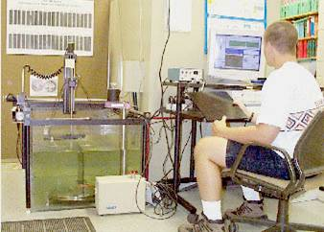
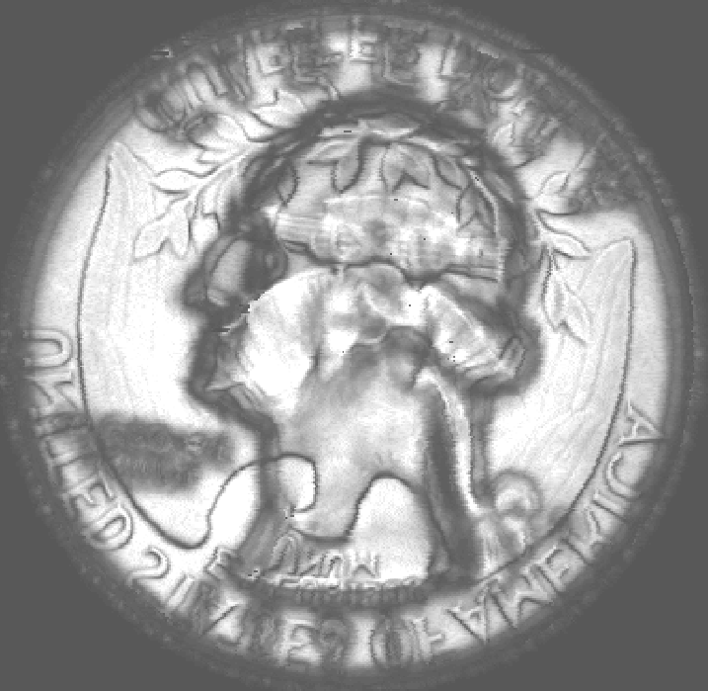

Ultrasonic Imaging
High resolution images can be produced by plotting signal strength or time-of-flight using a computer-controlled scanning system.
Gray scale image produced using the sound reflected from the front surface of the coin
Gray scale image produced using the sound reflected from the back surface of the coin (inspected from “heads” side)

Slide 71
Common Application of NDT
Inspection of Raw Products
Inspection Following Secondary Processing
In-Services Damage Inspection

Slide 72
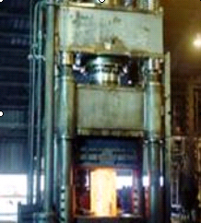
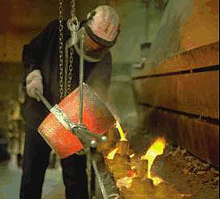
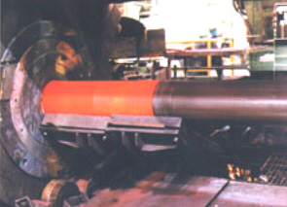
Inspection of Raw Products
Forgings,
Castings,
Extrusions,
etc.

Slide 73
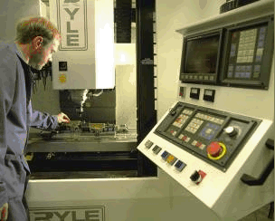
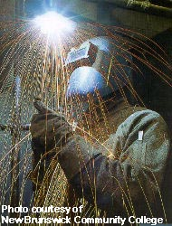



Inspection Following Secondary Processing
Machining
Welding
Grinding
Heat treating
Plating
etc.

Slide 74




Inspection For In-Service Damage
Cracking
Corrosion
Erosion/Wear
Heat Damage
etc.

Slide 75



Power Plant Inspection
Periodically, power plants are shutdown for inspection.
Inspectors feed eddy current probes into heat exchanger tubes to check for corrosion damage.
Pipe with damage
Probe
Signals produced by various amounts of corrosion thinning.

Slide 76





Wire Rope Inspection
Electromagnetic devices and visual inspections are used to find broken wires and other damage to the wire rope that is used in chairlifts, cranes and other lifting devices.

Slide 77




Storage Tank Inspection
Robotic crawlers use ultrasound to inspect the walls of large above ground tanks for signs of thinning due to corrosion.
Cameras on long articulating arms are used to inspect underground storage tanks for damage.

Slide 78



Aircraft Inspection
Nondestructive testing is used extensively during the manufacturing of aircraft.
NDT is also used to find cracks and corrosion damage during operation of the aircraft.
A fatigue crack that started at the site of a lightning strike is shown below.

Slide 79



Jet Engine Inspection
Aircraft engines are overhauled after being in service for a period of time.
They are completely disassembled, cleaned, inspected and then reassembled.
Fluorescent penetrant inspection is used to check many of the parts for cracking.

Slide 80

Crash of United Flight 232
Sioux City, Iowa, July 19, 1989
A defect that went undetected in an engine disk was responsible for the crash of United Flight 232.

Slide 81


Pressure Vessel Inspection
The failure of a pressure vessel can result in the rapid release of a large amount of energy. To protect against this dangerous event, the tanks are inspected using radiography and ultrasonic testing.

Slide 82




Rail Inspection
Special cars are used to inspect thousands of miles of rail to find cracks that could lead to a derailment.
Notes:
The heavy loads that trains place on the railroad tracks can result in the formation of cracks in the rail. If these cracks are not detected, they can lead to a derailment. Special rail cars equipped with NDT equipment are used to detect rail defects before they are big enough to cause serious problems.

Slide 83



Bridge Inspection
The US has 578,000 highway bridges.
Corrosion, cracking and other damage can all affect a bridge’s performance.
The collapse of the Silver Bridge in 1967 resulted in loss of 47 lives.
Bridges get a visual inspection about every 2 years.
Some bridges are fitted with acoustic emission sensors that “listen” for sounds of cracks growing.
Notes:
The US has 578,000 highway bridges, which are the lifelines of US commerce. Corrosion, cracking and other damage can all affect the bridges load carrying capacity. Therefore, all of the elements that directly affect performance of the bridge including the footing, substructure, deck, and superstructure must be periodically inspected or monitored. Visual inspection is the primary NDE method used to evaluate the condition of the majority of the nation's highway bridges. Inspectors periodically (about every two years) pay each bridge a visit to assess its condition. However, it is not uncommon for a fisherman, canoeist and other passerby to alert officials to major damage that may have occurred between inspections.
The potential penalties for ineffective inspection of bridges can be very severe. Instances of major bridge collapse are very rare, but the results are truly catastrophic. The collapse of the famous Silver Bridge at Point Pleasant, Ohio in 1967 resulted in loss of 47 lives. The cost of this disaster was 175 million dollars but some experts estimate the same occurrence today would cost between 2.1 and 5.6 billion dollars. Furthermore, these cost figures do not take into account factors such as loss of business resulting from loss of access or detours, the cost resulting from blockage of a major river shipping channel, and potential environmental damage due to hazardous materials being transported over the bridge at the time of collapse.
Fatigue cracking and corrosion will become increasingly important considerations as we go beyond the 75 year life expectancy and current visual inspection techniques will not suffice. The life extension approach will require increased use of NDE in a coordinated effort to obtain reliability assurance for these structures. NDE techniques such as magnetic particle inspection and ultrasonic inspection are being used with greater frequency. One of the newer NDE technologies being used is acoustic emission (AE) monitoring. Some bridges are being fitted with AE instruments that listen to the sounds that a bridge makes. These sophisticated systems can detect the sound energy produced when a crack grows and alert the inspector to the cracks presence. Sensors can be permanently fixed to the bridge and the data transmitted back to the lab so that continuous bridge condition monitoring is possible. The image provided here shows field engineers installing an AE monitoring system on the lift cables of the Ben Franklin Bridge in Philadelphia, PA

Slide 84



Pipeline Inspection
NDT is used to inspect pipelines to prevent leaks that could damage the environment. Visual inspection, radiography and electromagnetic testing are some of the NDT methods used.
Remote visual inspection using a robotic crawler.
Magnetic flux leakage inspection. This device, known as a pig, is placed in the pipeline and collects data on the condition of the pipe as it is pushed along by whatever is being transported.
Radiography of weld joints.

Slide 85


Special Measurements
Boeing employees in Philadelphia were given the privilege of evaluating the Liberty Bell for damage using NDT techniques. Eddy current methods were used to measure the electrical conductivity of the Bell's bronze casing at various points to evaluate its uniformity.
For more detail contact us

